Slide 1
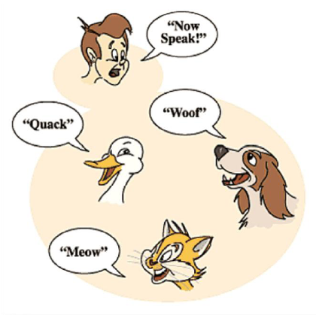
VTables
C++ Polymorphism "Under the Hood"

Slide 2
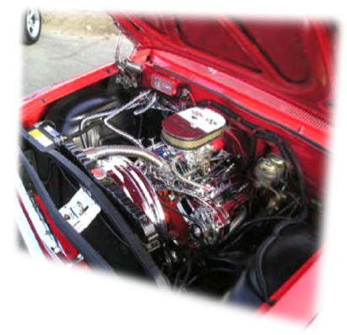
Under the Hood
Given this class:
class Animal
{
char* speak;
public:
Animal();
~Animal();
virtual char* getSpeak();
virtual void setSpeak(char*);
void Speak();
};

Slide 3
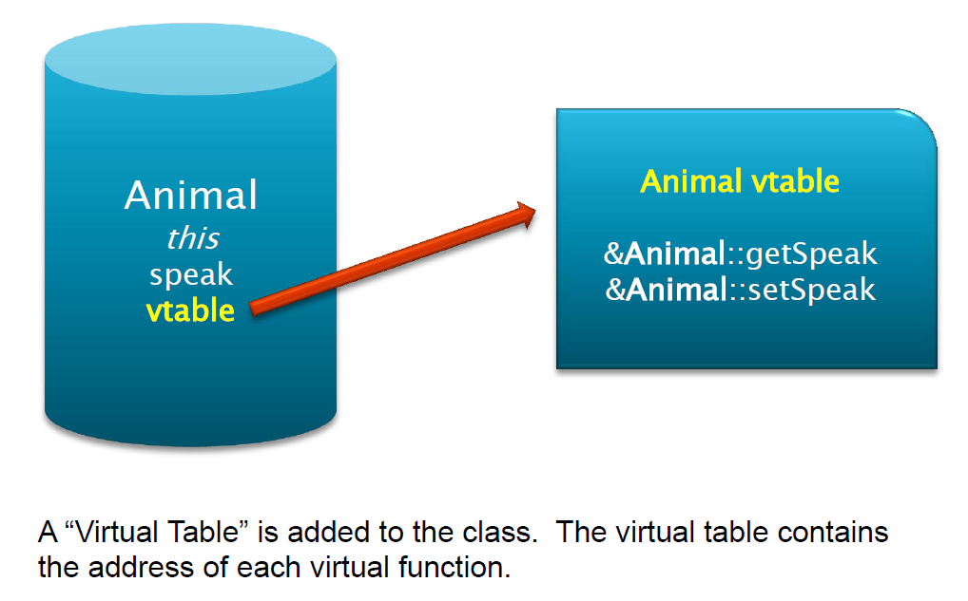
A data instance of an animal looks like this:

Slide 4
If you derive a class from the Animal class:
class Dog : Animal
{
public:
Dog();
~Dog();
char* getSpeak();
void setSpeak(char*);
void function();
};

Slide 5
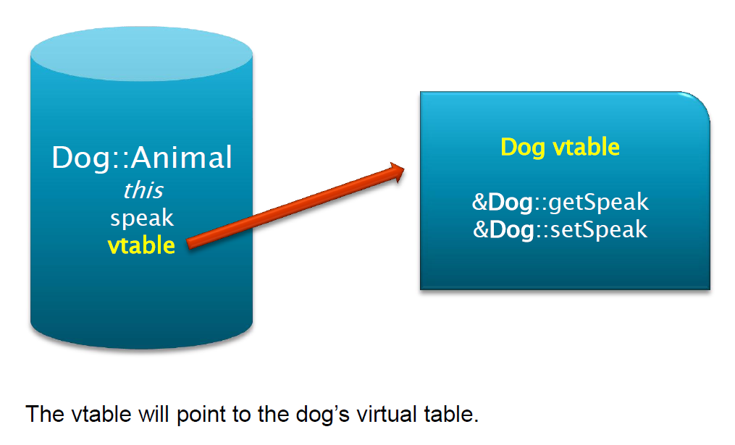
A data instance of a Dog looks like this:

Slide 6
When you call one of the Animal virtual functions:
Animal* ap = new Animal();
ap->getSpeak();
What is really happening is this:
ap->vtable->AnimalVtable>&Animal::getSpeak();

Slide 7
When you call one of the Dog virtual functions:
Animal* dp = new Dog();
dp->getSpeak();
What is really happening is this:
dp->vtable->DogVtable->&Dog::getSpeak();

Slide 8
Summary
All classes that have virtual functions have a “virtual table” implicitly added by the compiler to the class.
At runtime, the virtual function that gets used is the function in the active “virtual table”.
Virtual functions make designing an interface easier, in that the interface for accessing a base class is the same for accessing a derived class.

